Slide 1
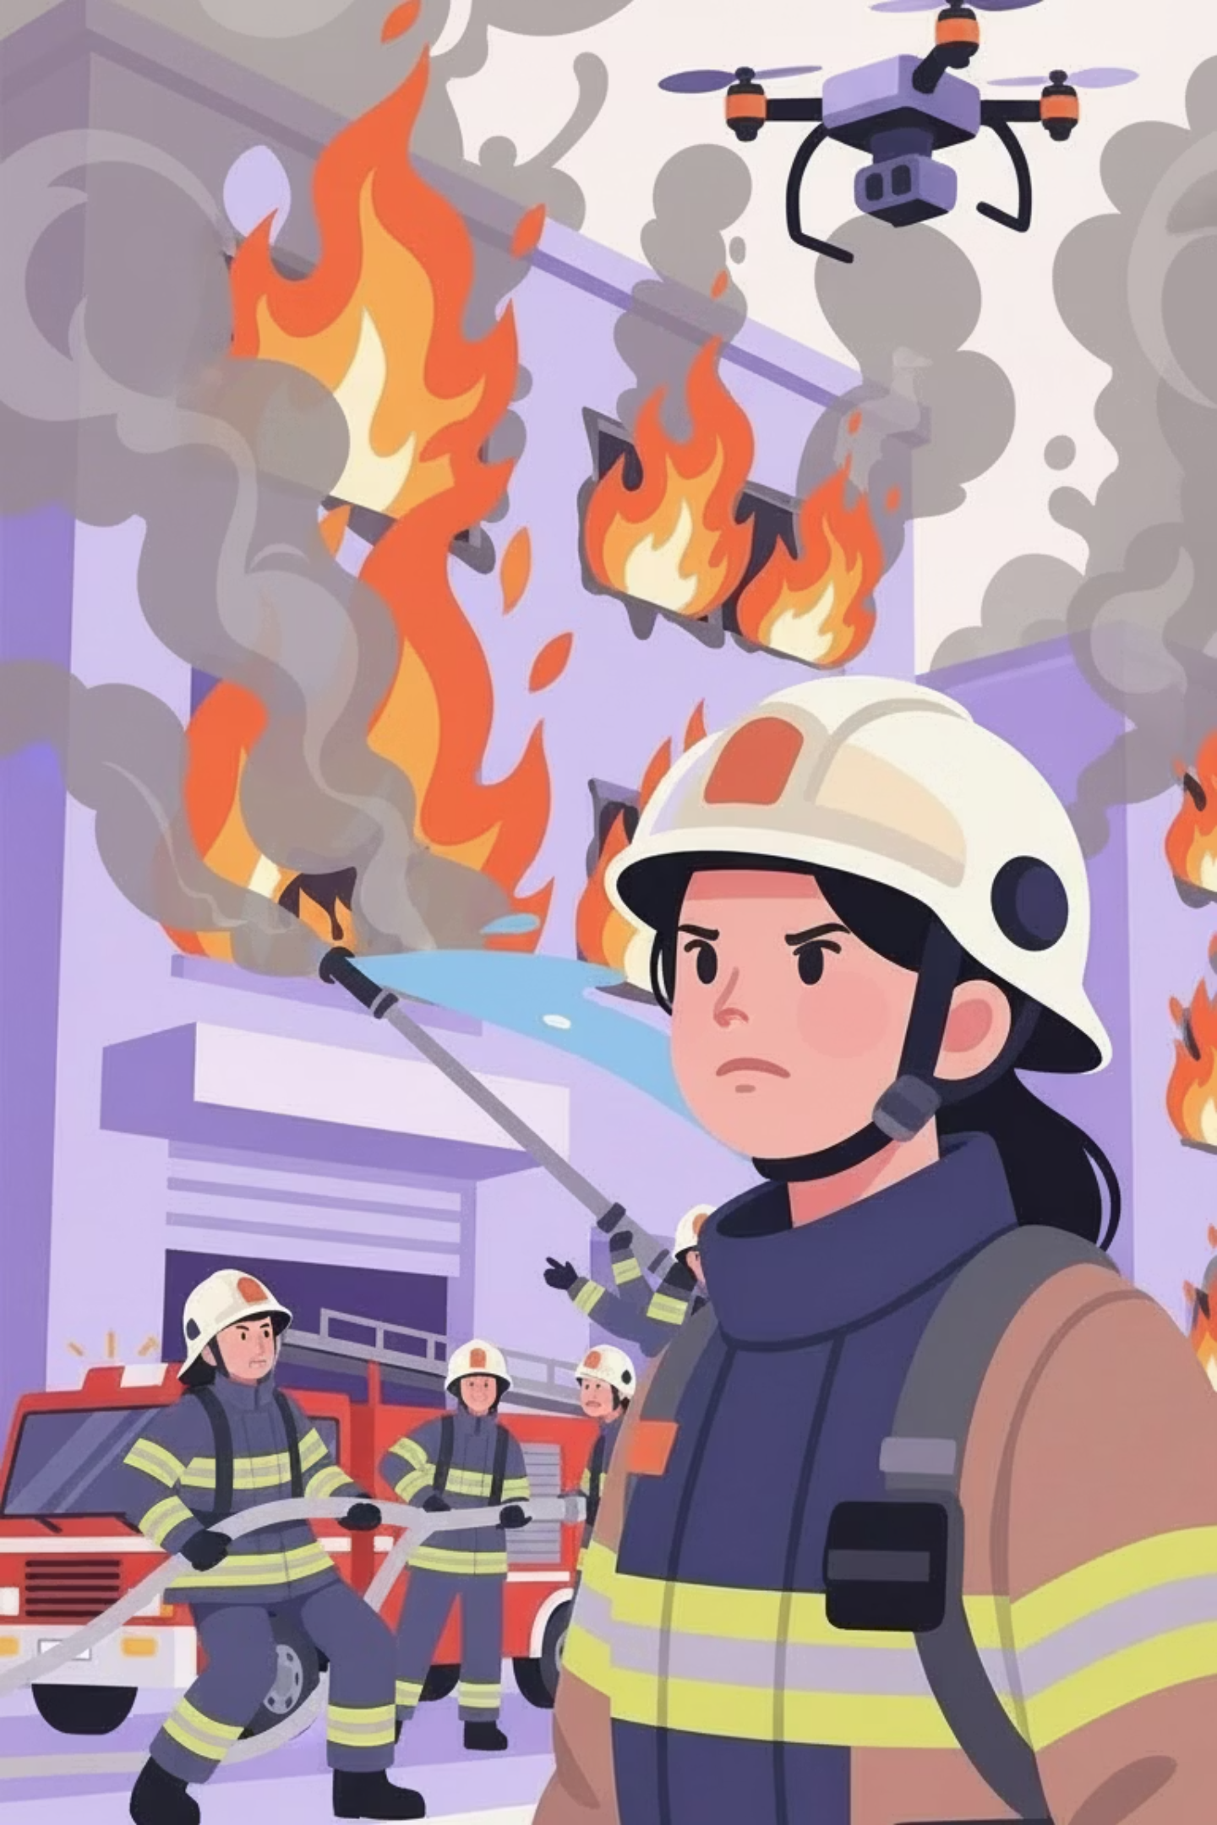
Proposal - Drone For Your Safety- GenAI
Presented by: Yuval Pery, Rachel Sade and Shaked Horesh

Slide 2
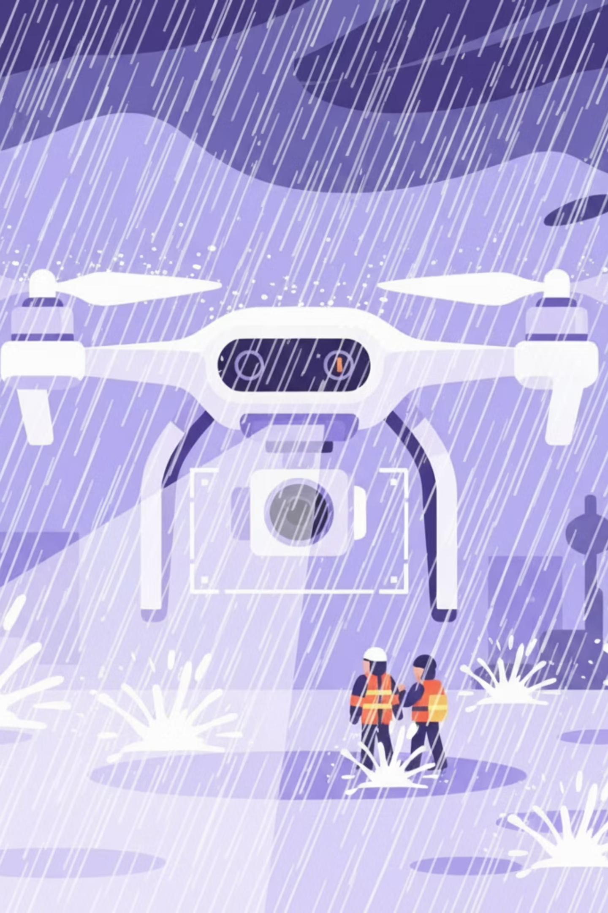
Motivating Use Case: Robust SAR in Extreme Weather
Background: Drone-based Search and Rescue (SAR) is critical for rapid survivor location during extreme weather events (e.g. hurricanes, fog, blizzards).
Importance: Stormy conditions (such as heavy rain, dense snow, or fog) cause severe visual degradation, rendering standard video feeds unusable for human operators or basic algorithms.
The Challenge: Conventional Object Detection models fail due to Domain Shift—they cannot generalize features learned from clear images to noisy, low-visibility environments.
Current Solutions: Existing solutions rely on expensive thermal sensors or slow manual inspection, lacking a scalable, real-time visual enhancement capability.
Notes:
תוסיף לתמונה רחפן לצד הכבאי

Slide 3



Project Task: Reliable Object Detection in Hazardous Conditions
Formal Problem Statement:
Input/Output
Development of a robust object detection pipeline specialized for extreme weather events, capable of identifying survivors and hazards in zero-visibility conditions where standard drone feeds fail.
Input: Noisy RGB images simulating drone footage in adverse weather.
Output: Precise Bounding Boxes and Confidence Scores for target objects
Novelty
A novel data generation pipeline that synthesizes realistic extreme weather overlays onto standard imagery. This enables training detection models to 'see through' severe visual obstructions, significantly enhancing reliability for Search and Rescue operations.
Notes:
תוסיף לתמונה רחפן שההולוגרמה של המפה מוארת ממנו במקום מהחיוך של הכבאים

Slide 4

Models and Methods
Processing Pipeline
The workflow begins with a data preparation phase, generating synthetic training samples by applying realistic weather effects to clear imagery. This augmented dataset drives the fine-tuning of the detection model, enabling precise bounding box prediction on individual static frames.
1
Models & Techniques
2
We employ Stable Diffusion with ControlNet to add extreme weather while preserving the original object shapes . For detection, the DETR (Transformer) model uses Self-Attention to understand the full image context.
Fine-Tuning & Adjustments
Training employs a Transfer Learning strategy, initializing with COCO pre-trained weights to leverage established feature representations. Optimization involves freezing the ResNet backbone while exclusively fine-tuning the transformer heads on the target "Adverse Weather" dataset to bridge the domain gap.
3

Slide 5
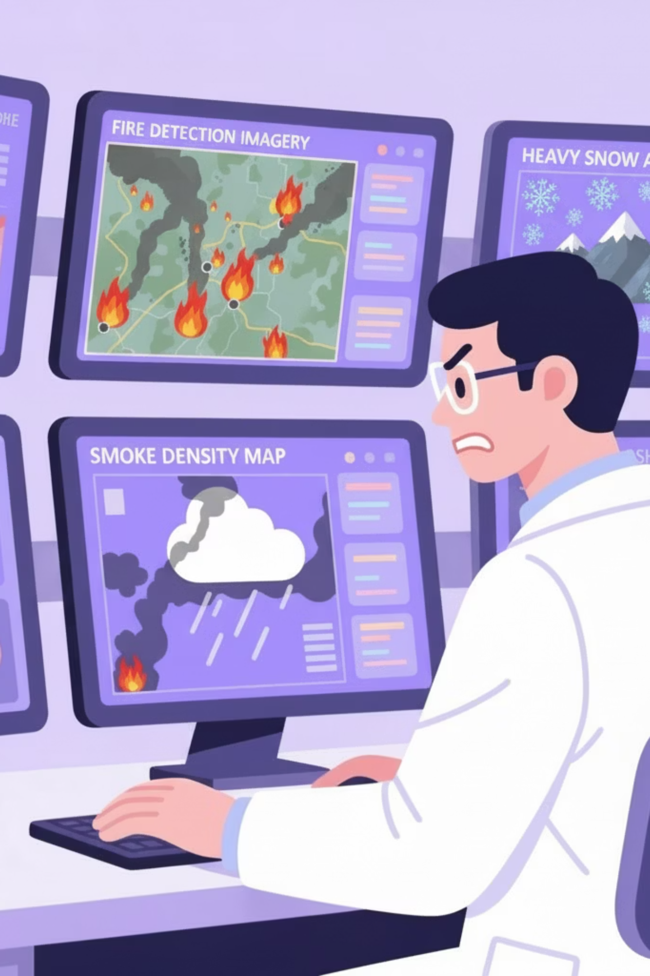
Data specification and generation
Data & Evaluation Requirements
Selected Datasets
Microsoft COCO is selected as the foundational source for diverse object features. The YOLO dataset is integrated to benchmark detection performance against authentic, non-synthetic adverse weather scenarios .
The project necessitates high-quality RGB imagery containing target classes (e.g. Person, Vehicle) under varying poses. Evaluation demands a strict separation between generated training data and real-world disaster footage to rigorously test model robustness.
Labeling Strategy
An Automatic Label Inheritance workflow maps bounding boxes directly from source images to synthetic outputs, eliminating manual annotation. Label Studio is employed solely for Quality Assurance (QA) on random samples to verify alignment accuracy.

Slide 6
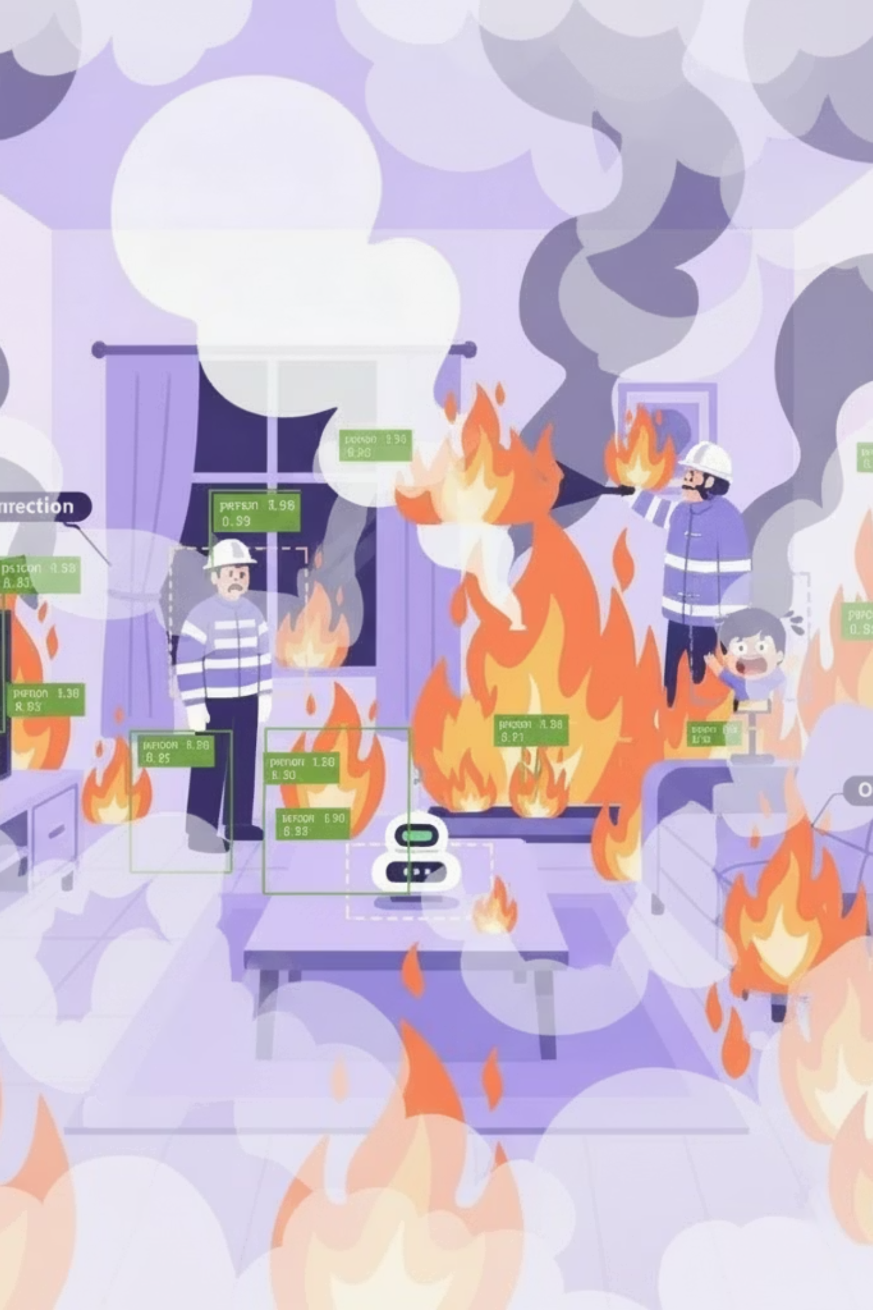
Performance Metrics and Key Indicators
mAP
P/R
100%
Mean Average Precision
Precision & Recall
Robustness
Assessing performance consistency across all specified extreme and disaster scenarios using mixed real and synthetic evaluation sets.
Measuring detection accuracy across multiple Intersection over Union (IoU) thresholds.
Evaluating the accuracy of positive predictions and the ability to find all relevant instances.
Our ground truth dataset combines real-world and synthetically generated data to rigorously validate model performance under varied and challenging conditions.

